Slide 1

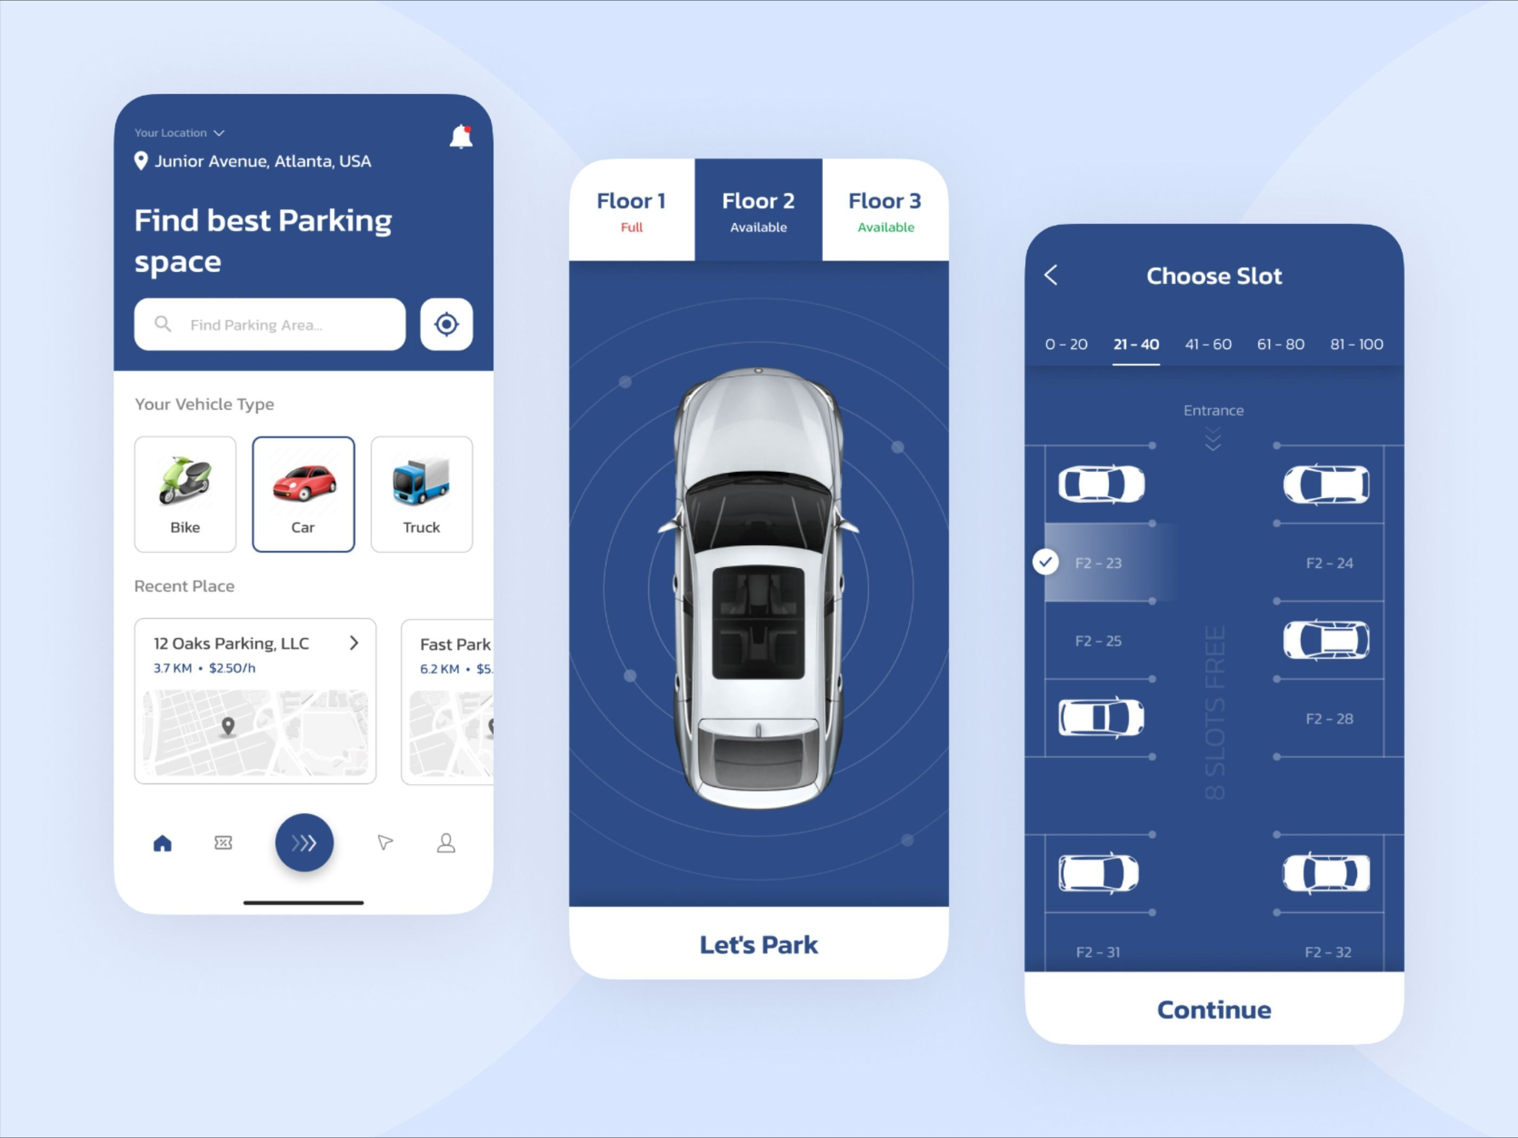

Park harbour
-Revolutionizing urban parking solutions
Presented By-
Harshal Ganesh Patil(239155)
Aman Gupta(239129)
GUIDED BY – GAURI KADAM

Slide 2
introduction
"Welcome to Park Harbour, a cutting-edge web application designed to revolutionize urban parking solutions. In the hustle and bustle of city life, finding a convenient parking spot for your vehicle can be a daunting task. Park Harbour emerges as the ultimate solution, employing advanced technologies such as Java, ReactJS, MySQL, and SpringBoot to seamlessly connect vehicle owners with available parking spaces.
Our user-centric platform not only simplifies the parking process through real-time location-based searches and reservation functionalities but also empowers individuals to become parking providers, creating a mutually beneficial community. With a robust security infrastructure, Park Harbour prioritizes the safety of your vehicle, providing a trustworthy environment for users.
The inclusion of an admin module ensures the smooth functioning of the application, allowing for dynamic parking fee management, issue resolution, and customer care support. Join Park Harbour today to experience hassle-free parking, enhanced safety, and the opportunity to contribute to a collaborative urban parking ecosystem."

Slide 3
abstract
"Park Harbour" is an innovative online web application designed to address the ever-growing parking challenges in urban and crowded areas. The platform serves as a comprehensive solution, connecting vehicle owners in need of parking spaces with individuals willing to provide secure parking facilities for 2 and 4-wheeler vehicles.
The application simplifies the process of finding parking spots by offering a user-friendly interface that allows users to locate available parking spaces in real-time, based on their specific location and preferences. Through Park Harbour, users can seamlessly reserve parking spaces, ensuring a hassle-free experience and reducing the stress associated with parking in densely populated areas.
Notably, Park Harbour goes beyond merely assisting vehicle owners in their quest for parking. The platform also empowers individuals to become parking providers, offering their available parking spaces to those in need. This dual-sided approach not only addresses the scarcity of parking but also opens up new opportunities for providers to earn additional income by monetizing their unused parking spaces.
Safety is a paramount concern, and Park Harbour prioritizes it by implementing robust security measures, ensuring the well-being of users' vehicles. The platform leverages advanced technologies to enhance the overall parking experience, promoting a sense of security and reliability.
The positive impact of Park Harbour extends beyond convenience and safety, contributing to the economic well-being of the community. By enabling individuals to earn supplementary income from their homes by providing parking spaces, the platform fosters a collaborative and mutually beneficial environment.
In summary, Park Harbour emerges as a transformative force in the realm of urban parking, mitigating parking challenges, enhancing safety, and creating economic opportunities for individuals. Through its user-centric approach, the platform aims to redefine the urban parking landscape, making it more efficient, secure, and community-driven.

Slide 4

Software requirements specifications
INTRODUCTION

Slide 5
1.1 PURPOSE
The purpose of the "Park Harbour" web application is to provide a user-friendly platform that addresses urban parking challenges by connecting vehicle owners with available parking spaces. It aims to streamline the parking process, enhance safety, and create economic opportunities for individuals willing to offer their parking spaces.
1.2 SCOPE
The application will be built using Java, ReactJS, MySQL, and SpringBoot. It will support real-time location-based searches, reservation functionalities, and a dual-sided approach allowing users to find parking spaces and individuals to become parking providers.

Slide 6
SYSTEM OVERVIEW
2.1 SYSTEM DESCRIPTION
"Park Harbour" will consist of a web-based interface accessible to users and parking providers. The system will utilize Java and Spring Boot for backend development, ReactJS for the frontend, and MySQL for database management.
2.2 FEATURES
User registration and authentication
Real-time location-based parking search
Reservation and payment functionality
Dual-sided system for users and parking providers
Secure user data management
Robust safety measures for vehicle protection

Slide 7
FUNCTIONAL REQUIREMENTS
3.1 USER MODULE
3.2 parking provider module
User registration and login
User profile management and User vehicle management
Real-time parking space search
Reservation and payment processing
Order History for users
Review and Feedback for Parking spaces
Provider registration and login
Parking space listing
Reservation confirmation and denial
Earnings tracking and management
Reviews management and Parking history

Slide 8
3.3 admin module
Admin login and authentication
Parking fee management and updates
User and provider oversight
Issue management and resolution
Customer care support and communication

Slide 9
Non - FUNCTIONAL REQUIREMENTS
4.1 performance
The system shall support a minimum of 1000 simultaneous users.
Response time for search and reservation processes should be within 3 seconds.
4.2 security
User data and payment information shall be encrypted and securely stored.
Access controls and authentication mechanisms shall be implemented.

Slide 10
database REQUIREMENTS
5.1 database design
MySQL will be used to store user profiles, parking space details, reservations, and financial transactions.
User interface REQUIREMENTS
6.1 user – friendly interface
The application shall have an intuitive and responsive UI using ReactJS.
Clear navigation and easy access to features.

Slide 11
SRS - conclusion
The "Park Harbour" SRS outlines the requirements for the development of a comprehensive web application addressing urban parking challenges. By leveraging Java, ReactJS, MySQL, and Spring Boot, the platform aims to redefine urban parking with a focus on convenience, safety, and economic opportunities.
SRS - constraints
The application will initially support English language only.
Availability of real-time location data for accurate parking space suggestions.

Slide 12
Hardware REQUIREMENTS
1 server :
2 database server :
3 client devices :
Dual-core processor or higher
Minimum 8 GB RAM
Solid State Drive (SSD) for faster data access
Reliable internet connection with sufficient bandwidth
Adequate storage space for the database
Recommended: Separate server for the database for better performance
Backup and recovery system for data protection
Personal computers, laptops, or tablets
Internet connectivity
Modern web browsers such as Google Chrome, Mozilla Firefox, or Safari

Slide 13
software REQUIREMENTS
1 operating system :
Server: Linux-based OS (e.g., Ubuntu, CentOS) or Windows Server
Database Server: Compatible OS with the chosen database management system
Client Devices: Windows, macOS, Linux, or any OS supported by modern web browsers
2 web server :
Apache, Nginx, or any other suitable web server
3 database management system :
MySQL (version compatible with Spring Boot)
Database administration tool for managing and monitoring the database (e.g., MySQL Workbench)

Slide 14
4 backend :
5 frontend :
Java Development Kit (JDK) - compatible version with Spring Boot
Spring Boot framework
ReactJS library
6 development tools :
Integrated Development Environment (IDE) for Java development (e.g., IntelliJ IDEA, Eclipse)
Code version control system (e.g., Git)
7 security :
8 miscellaneous :
Secure Sockets Layer (SSL) certificate for secure data transmission
Firewall configuration to control access to the server
Node.js for managing frontend dependencies
Package manager for Java (e.g., Maven)
Package manager for Node.js (e.g., npm)

Slide 15
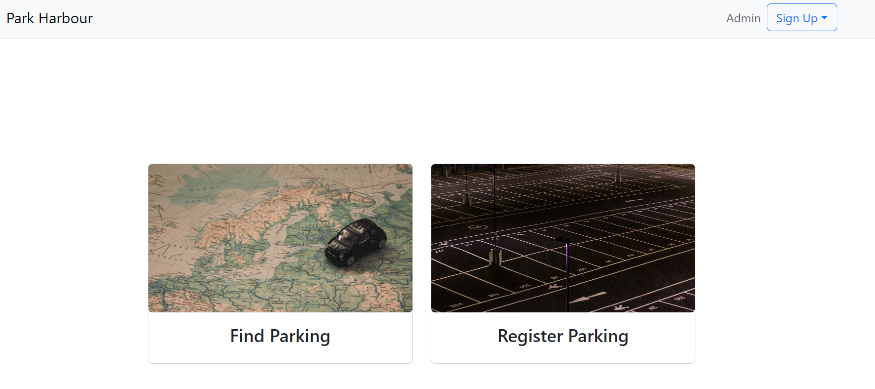
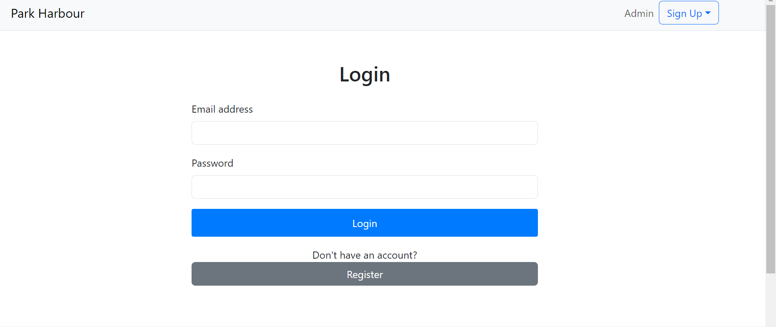
U S E R I N T E R F A C E

Slide 16
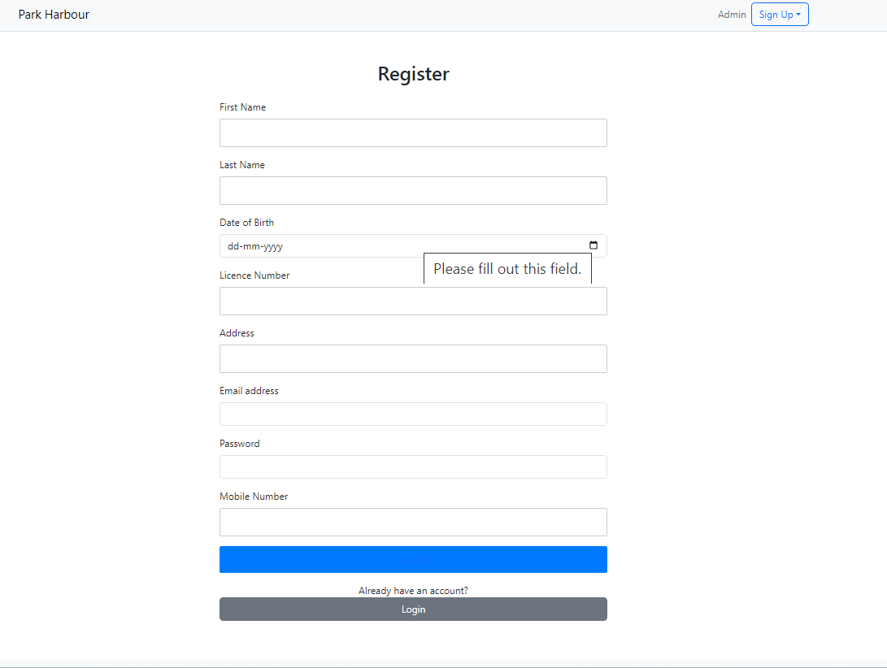
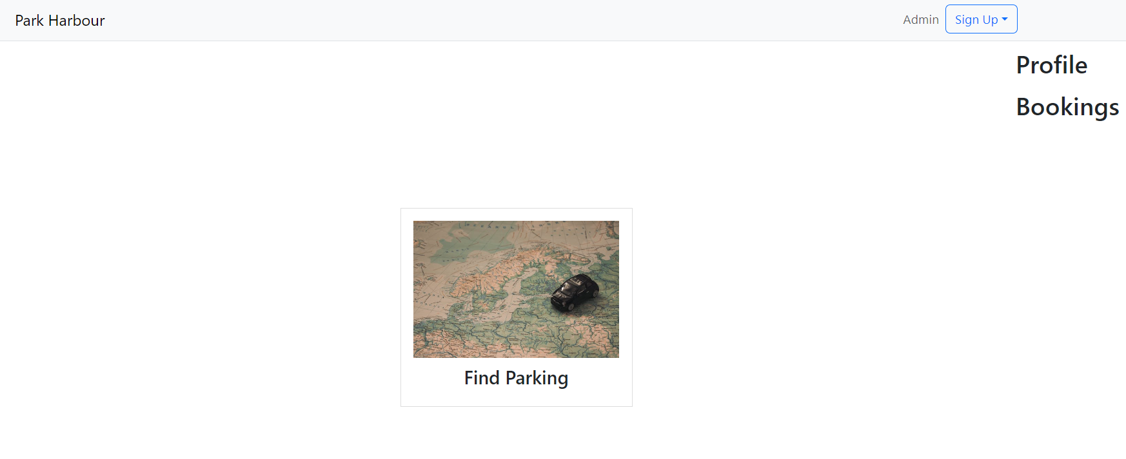
SIGN-UP PAGE
REGISTRATION PAGE

Slide 17
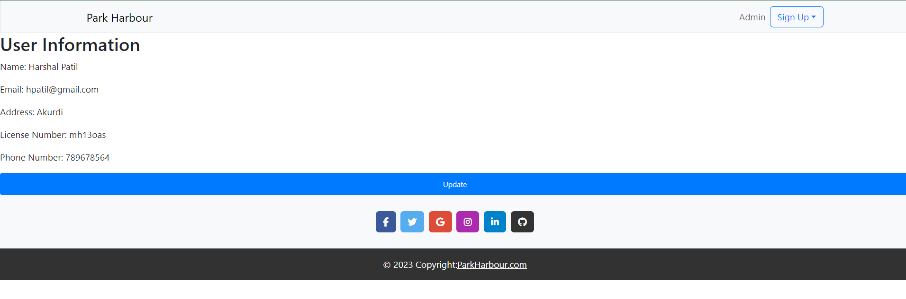
USER PROFILE PAGE

Slide 18
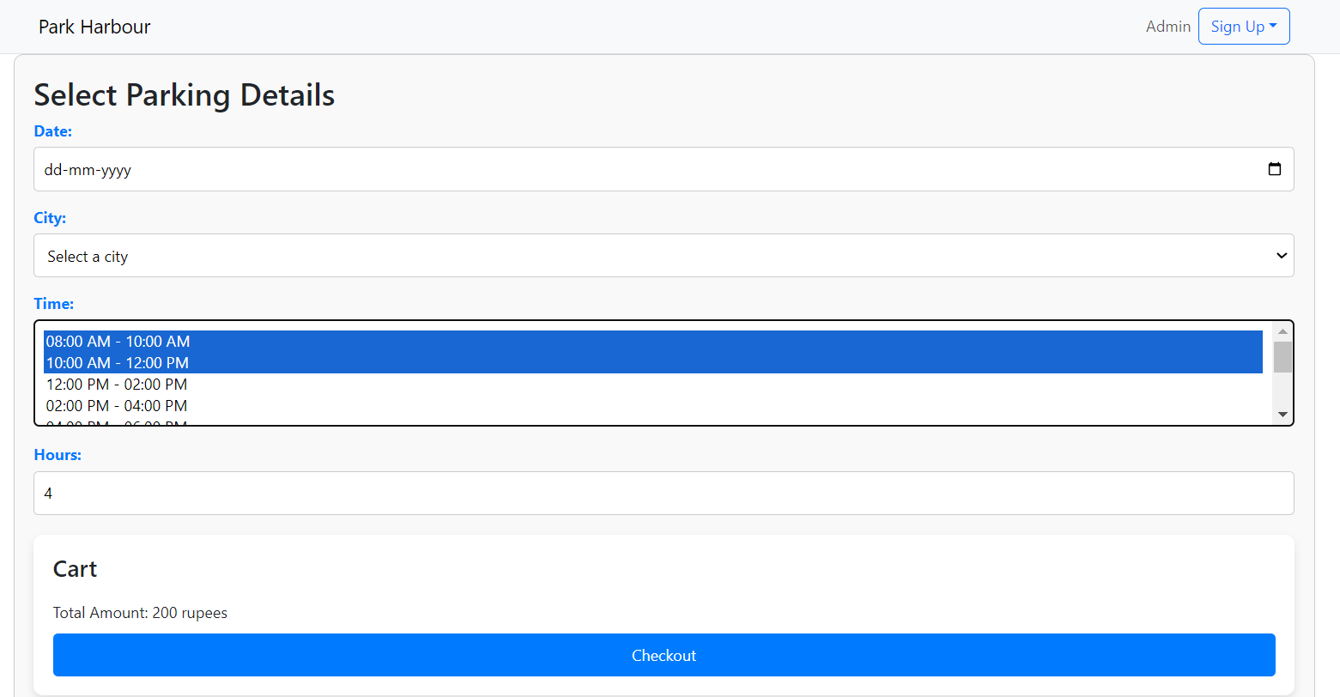
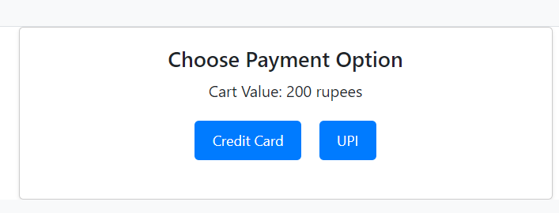
SLOT BOOKING AND PAYMENT OPTION PAGE

Slide 19
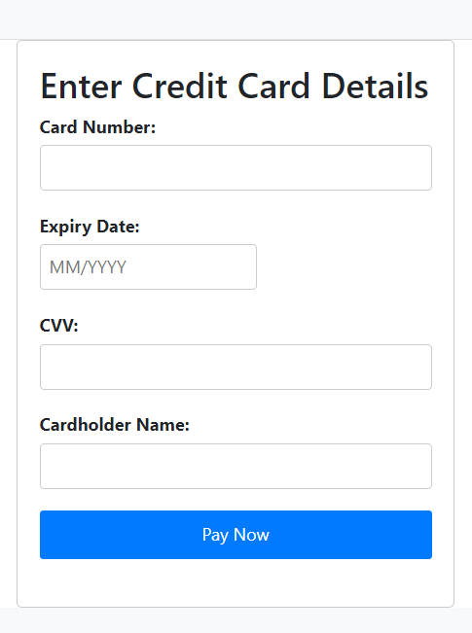


PAYMENT COMPLETION PAGE

Slide 20
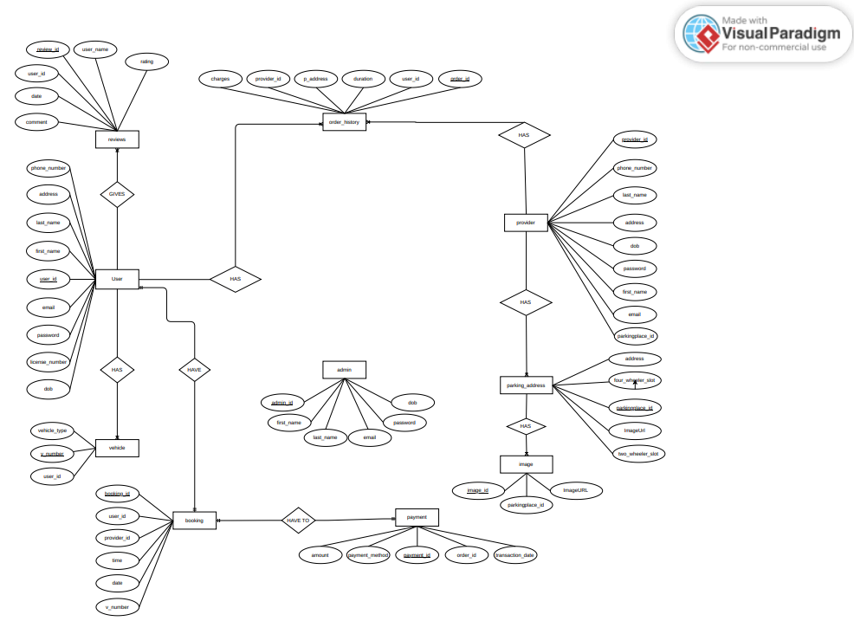
ENTITY RELATIONSHIP DIAGRAM

Slide 21
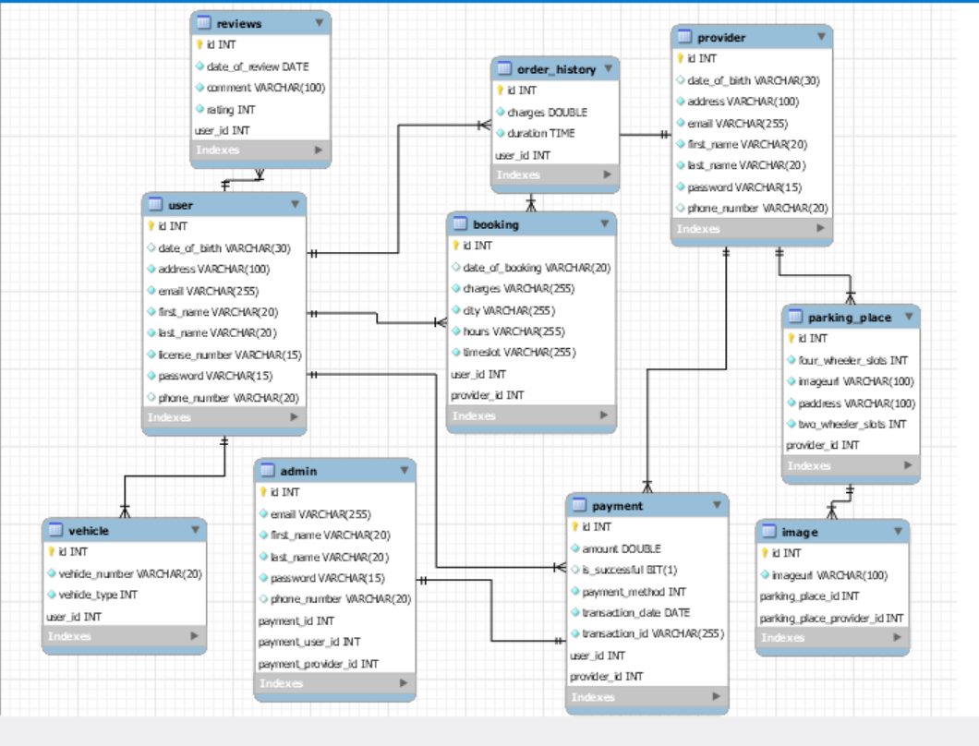
Uml diagram

Slide 22
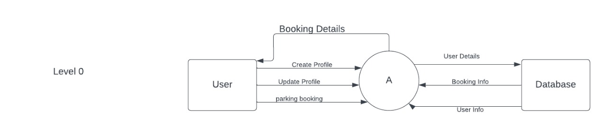
DFD DIAGRAM 1

Slide 23
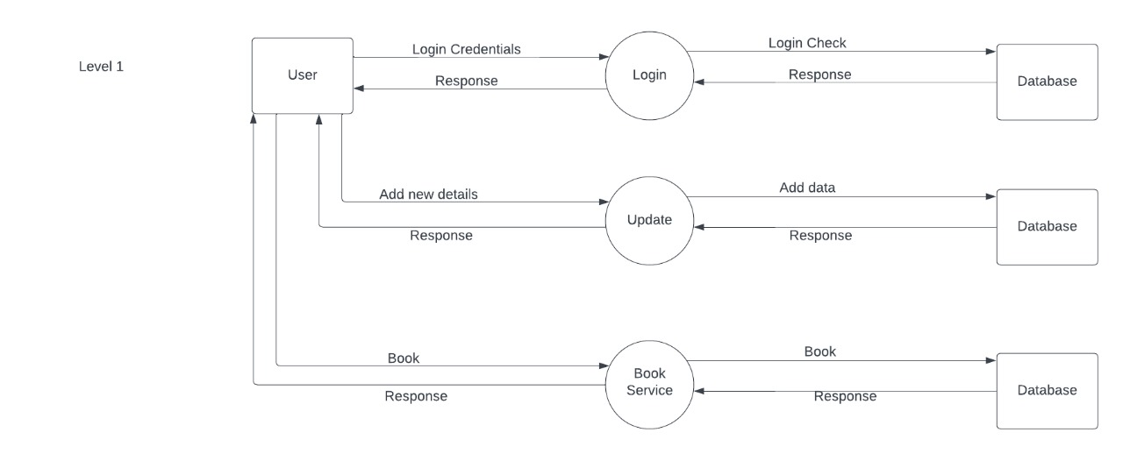
DFD DIAGRAM 2

Slide 24
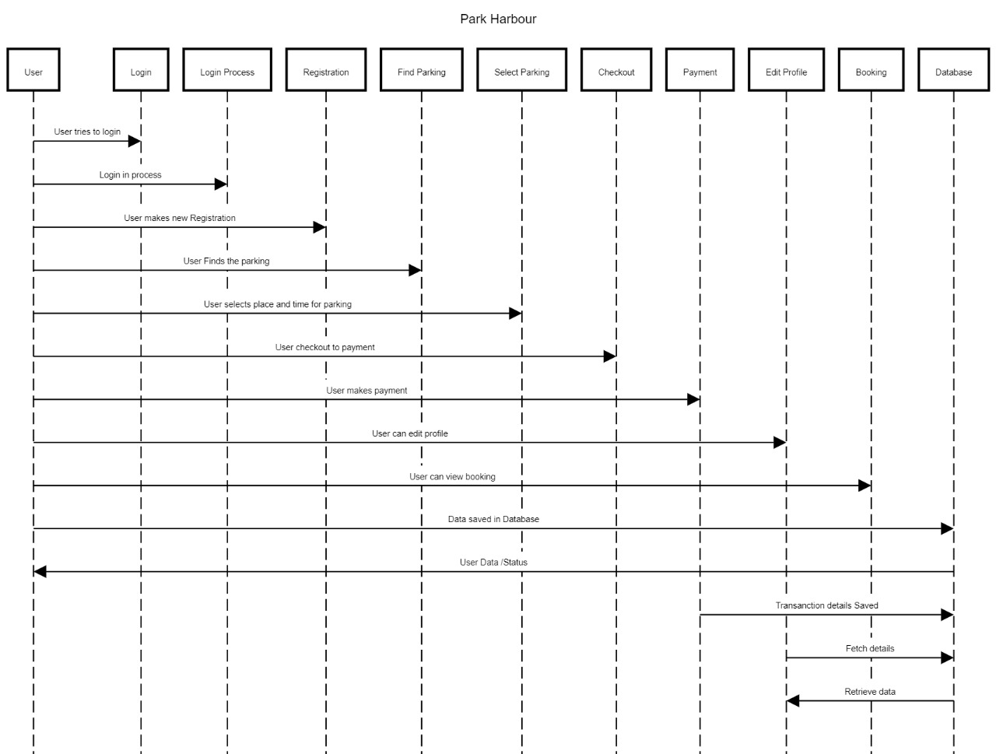
SEQUENCE DIAGRAM

Slide 25
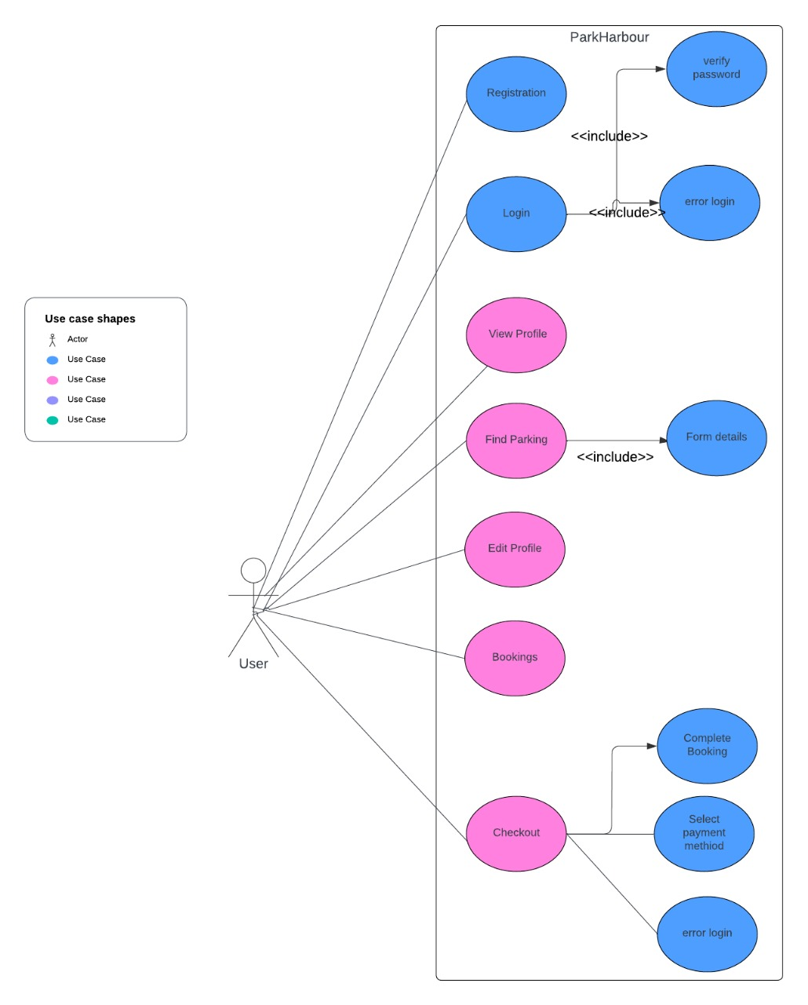
USE-CASE DIAGRAM

Slide 26
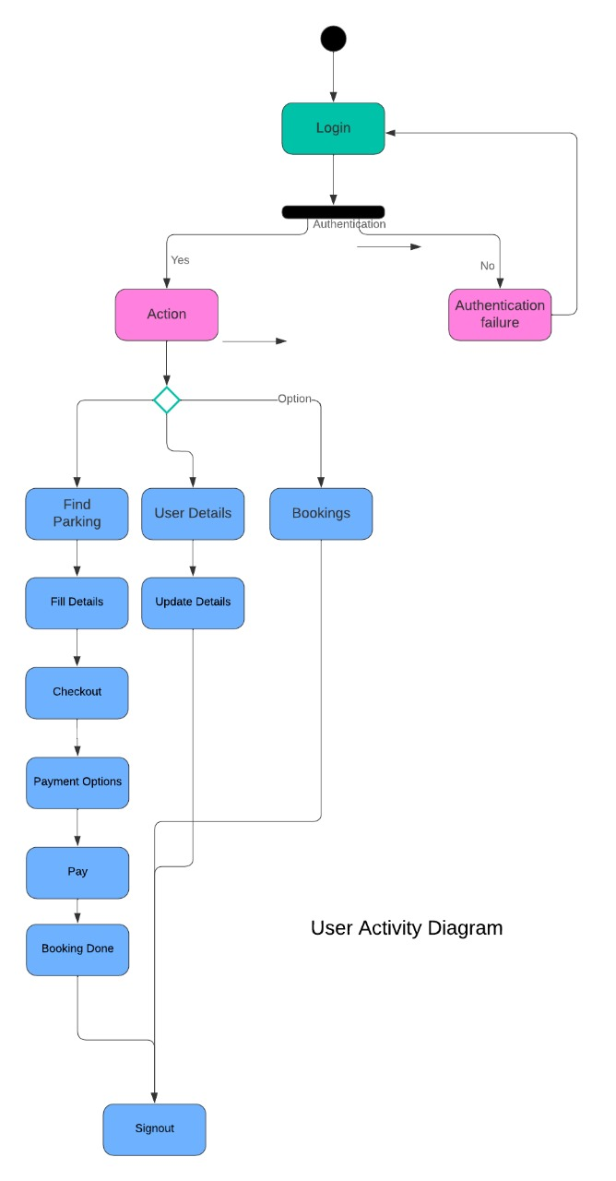
ACTIVITY DIAGRAM

Slide 27
THANK YOU

